Slide 1


Course: Object Oriented Programming
Collections and Relationships
Connecting objects with arrays, lists, and class-level design
Evis Plaku

Slide 2


motivation
How we feel after creating one class in Java
… with the help of ChatGPT

Slide 3

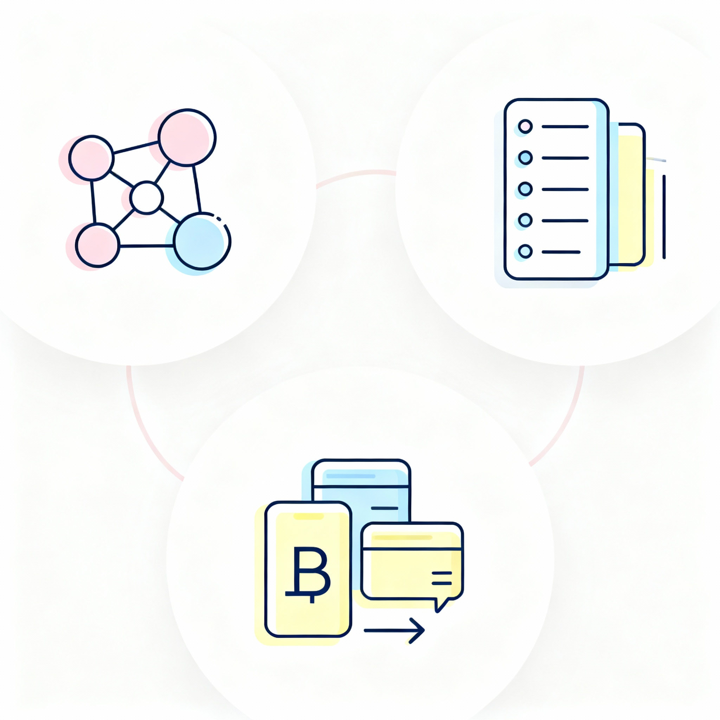
Lecture overview
Build solid software that grows using collections and relations
Focus: connect objects, manage collections, and model real relationships
Three parts: static/relationships, arrays and lists, bank application walkthrough
Goal: move from isolated classes to collaborating objects with clean design

Slide 4

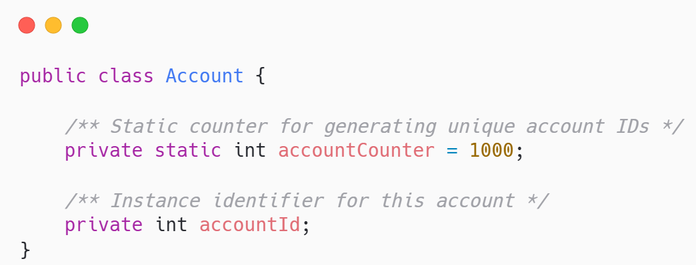
Class level vs instance level: the static keyword
Static belongs to the class instance belongs to each individual object
Static fields are shared by all objects; one copy for the whole class
Instance fields are unique per object; each object stores its own state
Account counter is class-wide; accountId is per account

Slide 5

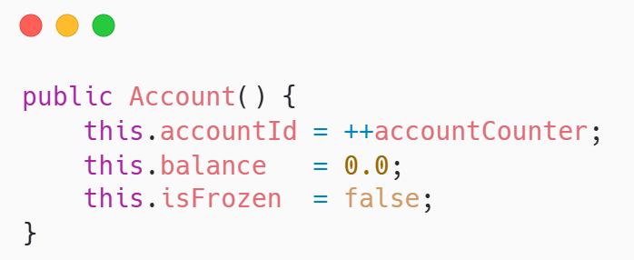
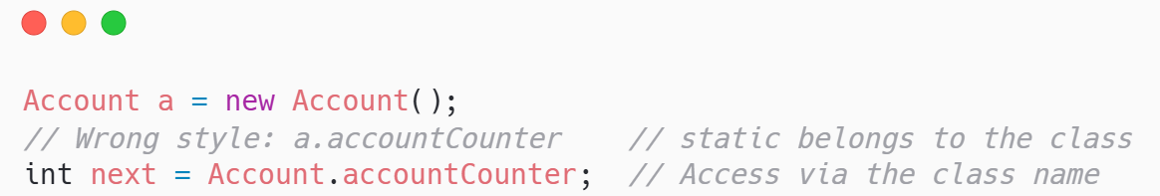
Static in practice
Use static for shared utilities and counters, not per-object state
Static methods cannot read instance fields unless given an object reference

Slide 6


Object relationship: introduction
Real programs connect objects: who owns what, and how many
Real systems link entities: customers own accounts; accounts contain transactions
Three common patterns: one-to-one links, one-to-many collections of objects, and many-to-many relationships
Implement with references for single links, collections for grouped relationships

Slide 7

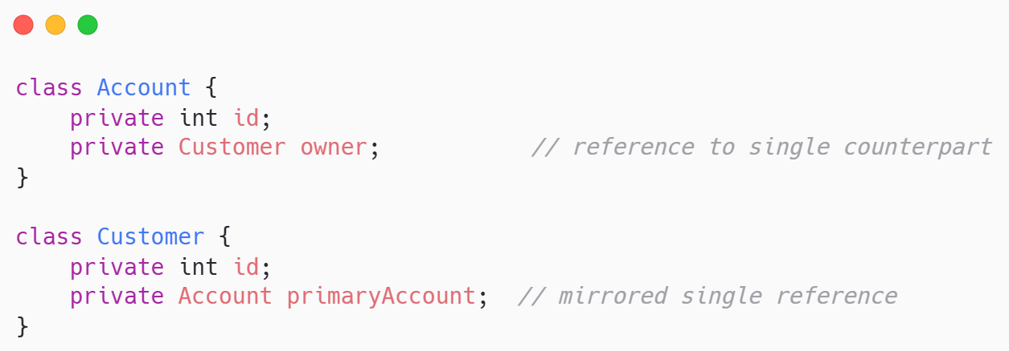
One to one relationships
Link one object to exactly one partner using a direct reference
Each object connects to a single counterpart, forming a unique pairing
Implement with a reference field; optionally mirror it on both classes

Slide 8

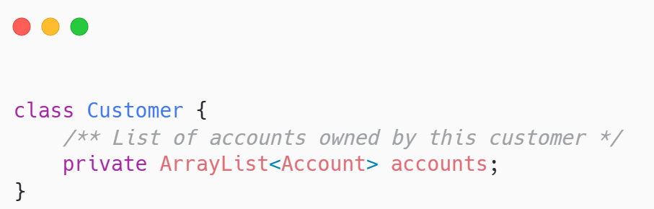
One to many relationships
One object manages a group of related objects using collections
One object links to several others; each child links back to one
Implement with a collection field on the “one” side, like a list

Slide 9

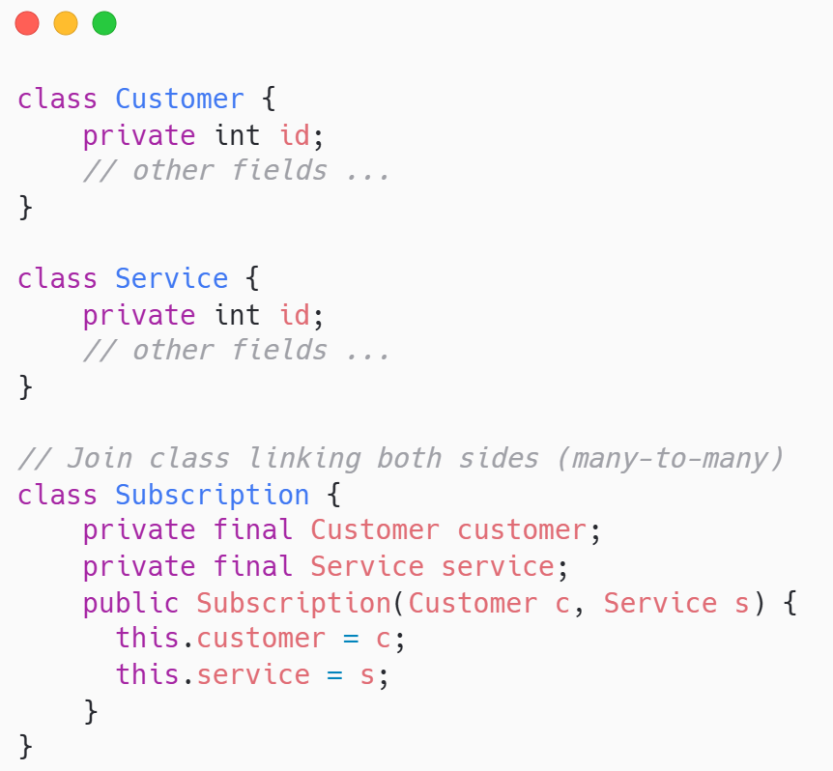
many to many relationships
Both sides have many; connect them with a dedicated linking class
Each object relates to many others, and the reverse is also true
Implement with a join class holding references to both linked objects
Customers access many Services; Services are used by many Customers

Slide 10

Collections of Objects
Arrays and Lists

Slide 11

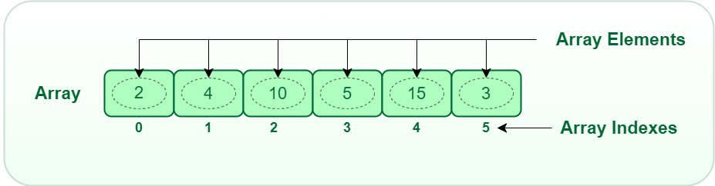
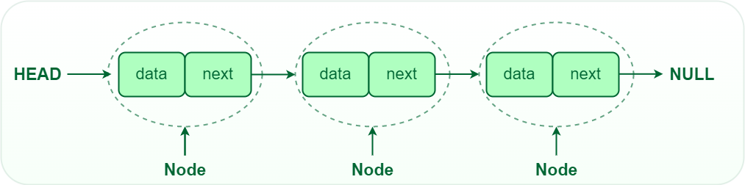
Why collections in oop
Manage groups of objects to model real tasks and workflows
Real applications track many objects together, not just single instances
Collections enable add, remove, search, and filter over related objects
Arrays and lists are core tools for storing and organizing objects

Slide 12

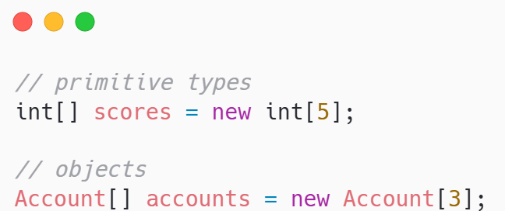
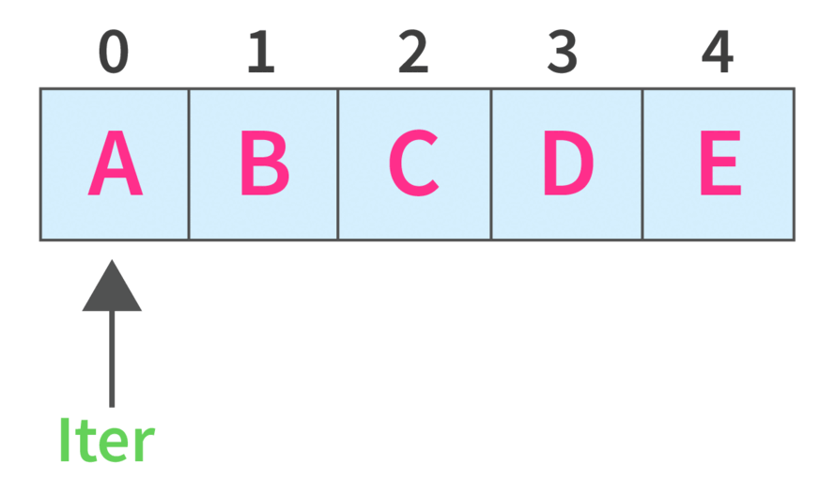
Arrays — Fixed-Size Collections
Arrays store a fixed number of elements with fast indexed access
Declare with type and size
Index access is constant-time; size cannot change after creation
Best when maximum capacity is known and predictable upfront

Slide 13
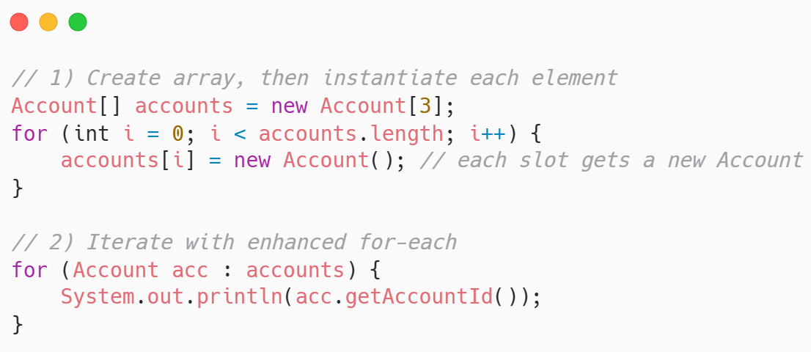
Arrays of objects: example
Initialize each slot, then iterate to use your object references
Create the array, then instantiate each object / element in a loop
Iterate using classic “for to” index, or enhanced for-each for clarity

Slide 14

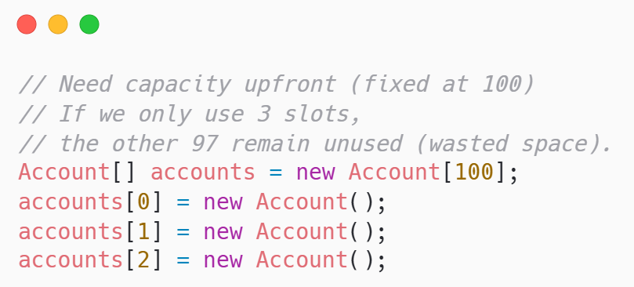
Array limitations
Arrays are fixed-size containers without rich operations built-in
Fixed size: you must know capacity in advance or waste memory space
No built-in search/insert/delete; you write manual indexing logic yourself

Slide 15

Array lists: dynamic collections
A resizable list of objects with convenient methods and indexing
Prefer ArrayList for dynamic sizing and convenient helper methods when growing
Grows and shrinks automatically as elements are added or removed
get
Get all
size
add
Add all
remove
clear
Is empty
contains
For each

Slide 16

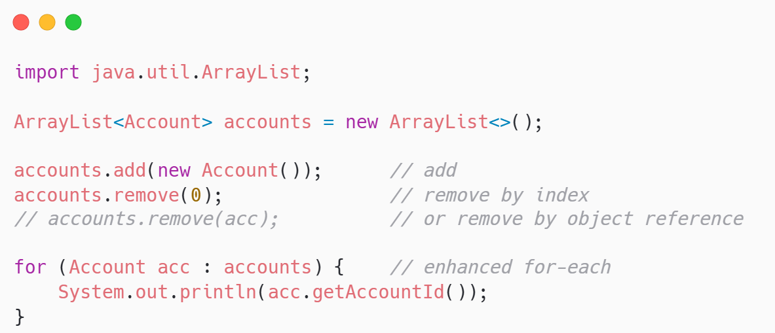
ArrayList Basics — Syntax & Operations
Declare, add, and access elements with simple, readable list syntax
Declare with proper import
Add or remove elements
Access elements or iterate through enhanced for each loops

Slide 17

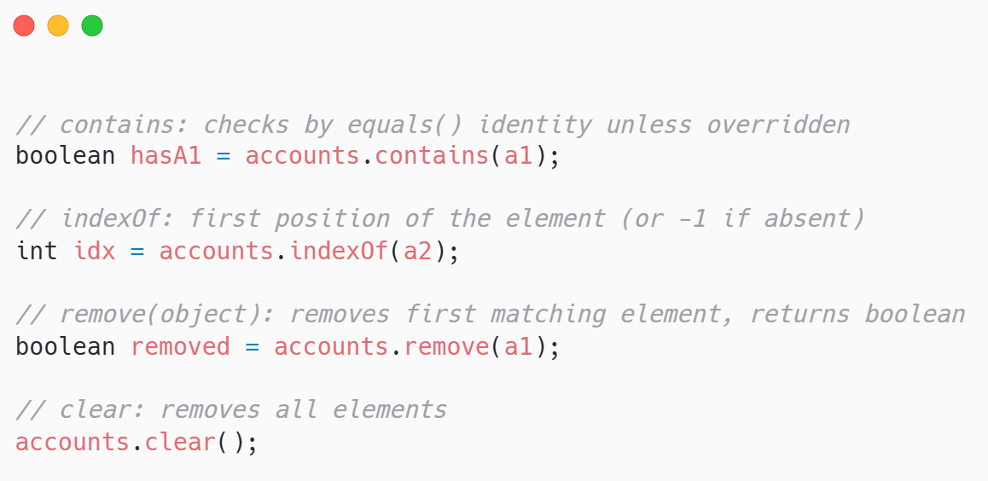
ArrayList Methods — Search & Modify
Find, iterate, and update list elements with simple, readable calls
Use contains(), indexOf(), remove(object), and clear() for common operations
Enhanced for-each to read items cleanly

Slide 18

Arrays vs ArrayList — When to Use Which
Fixed size vs dynamic growth pick based on stability and flexibility
Aspect | Arrays | ArrayList
Size behavior | Fixed at creation; cannot change later | Dynamic; grows and shrinks automatically
Ease of use | Manual add/remove and resizing logic required | Built-in add(), remove(), clear(), and more
Access syntax | Fast indexed access with a[i] | Indexed access with get(i), still fast
Data types | Supports primitives and objects directly | Objects only; primitives via autoboxing
Typical usage | Known capacity, performance-critical segments | Managing domain objects in application code

Slide 19
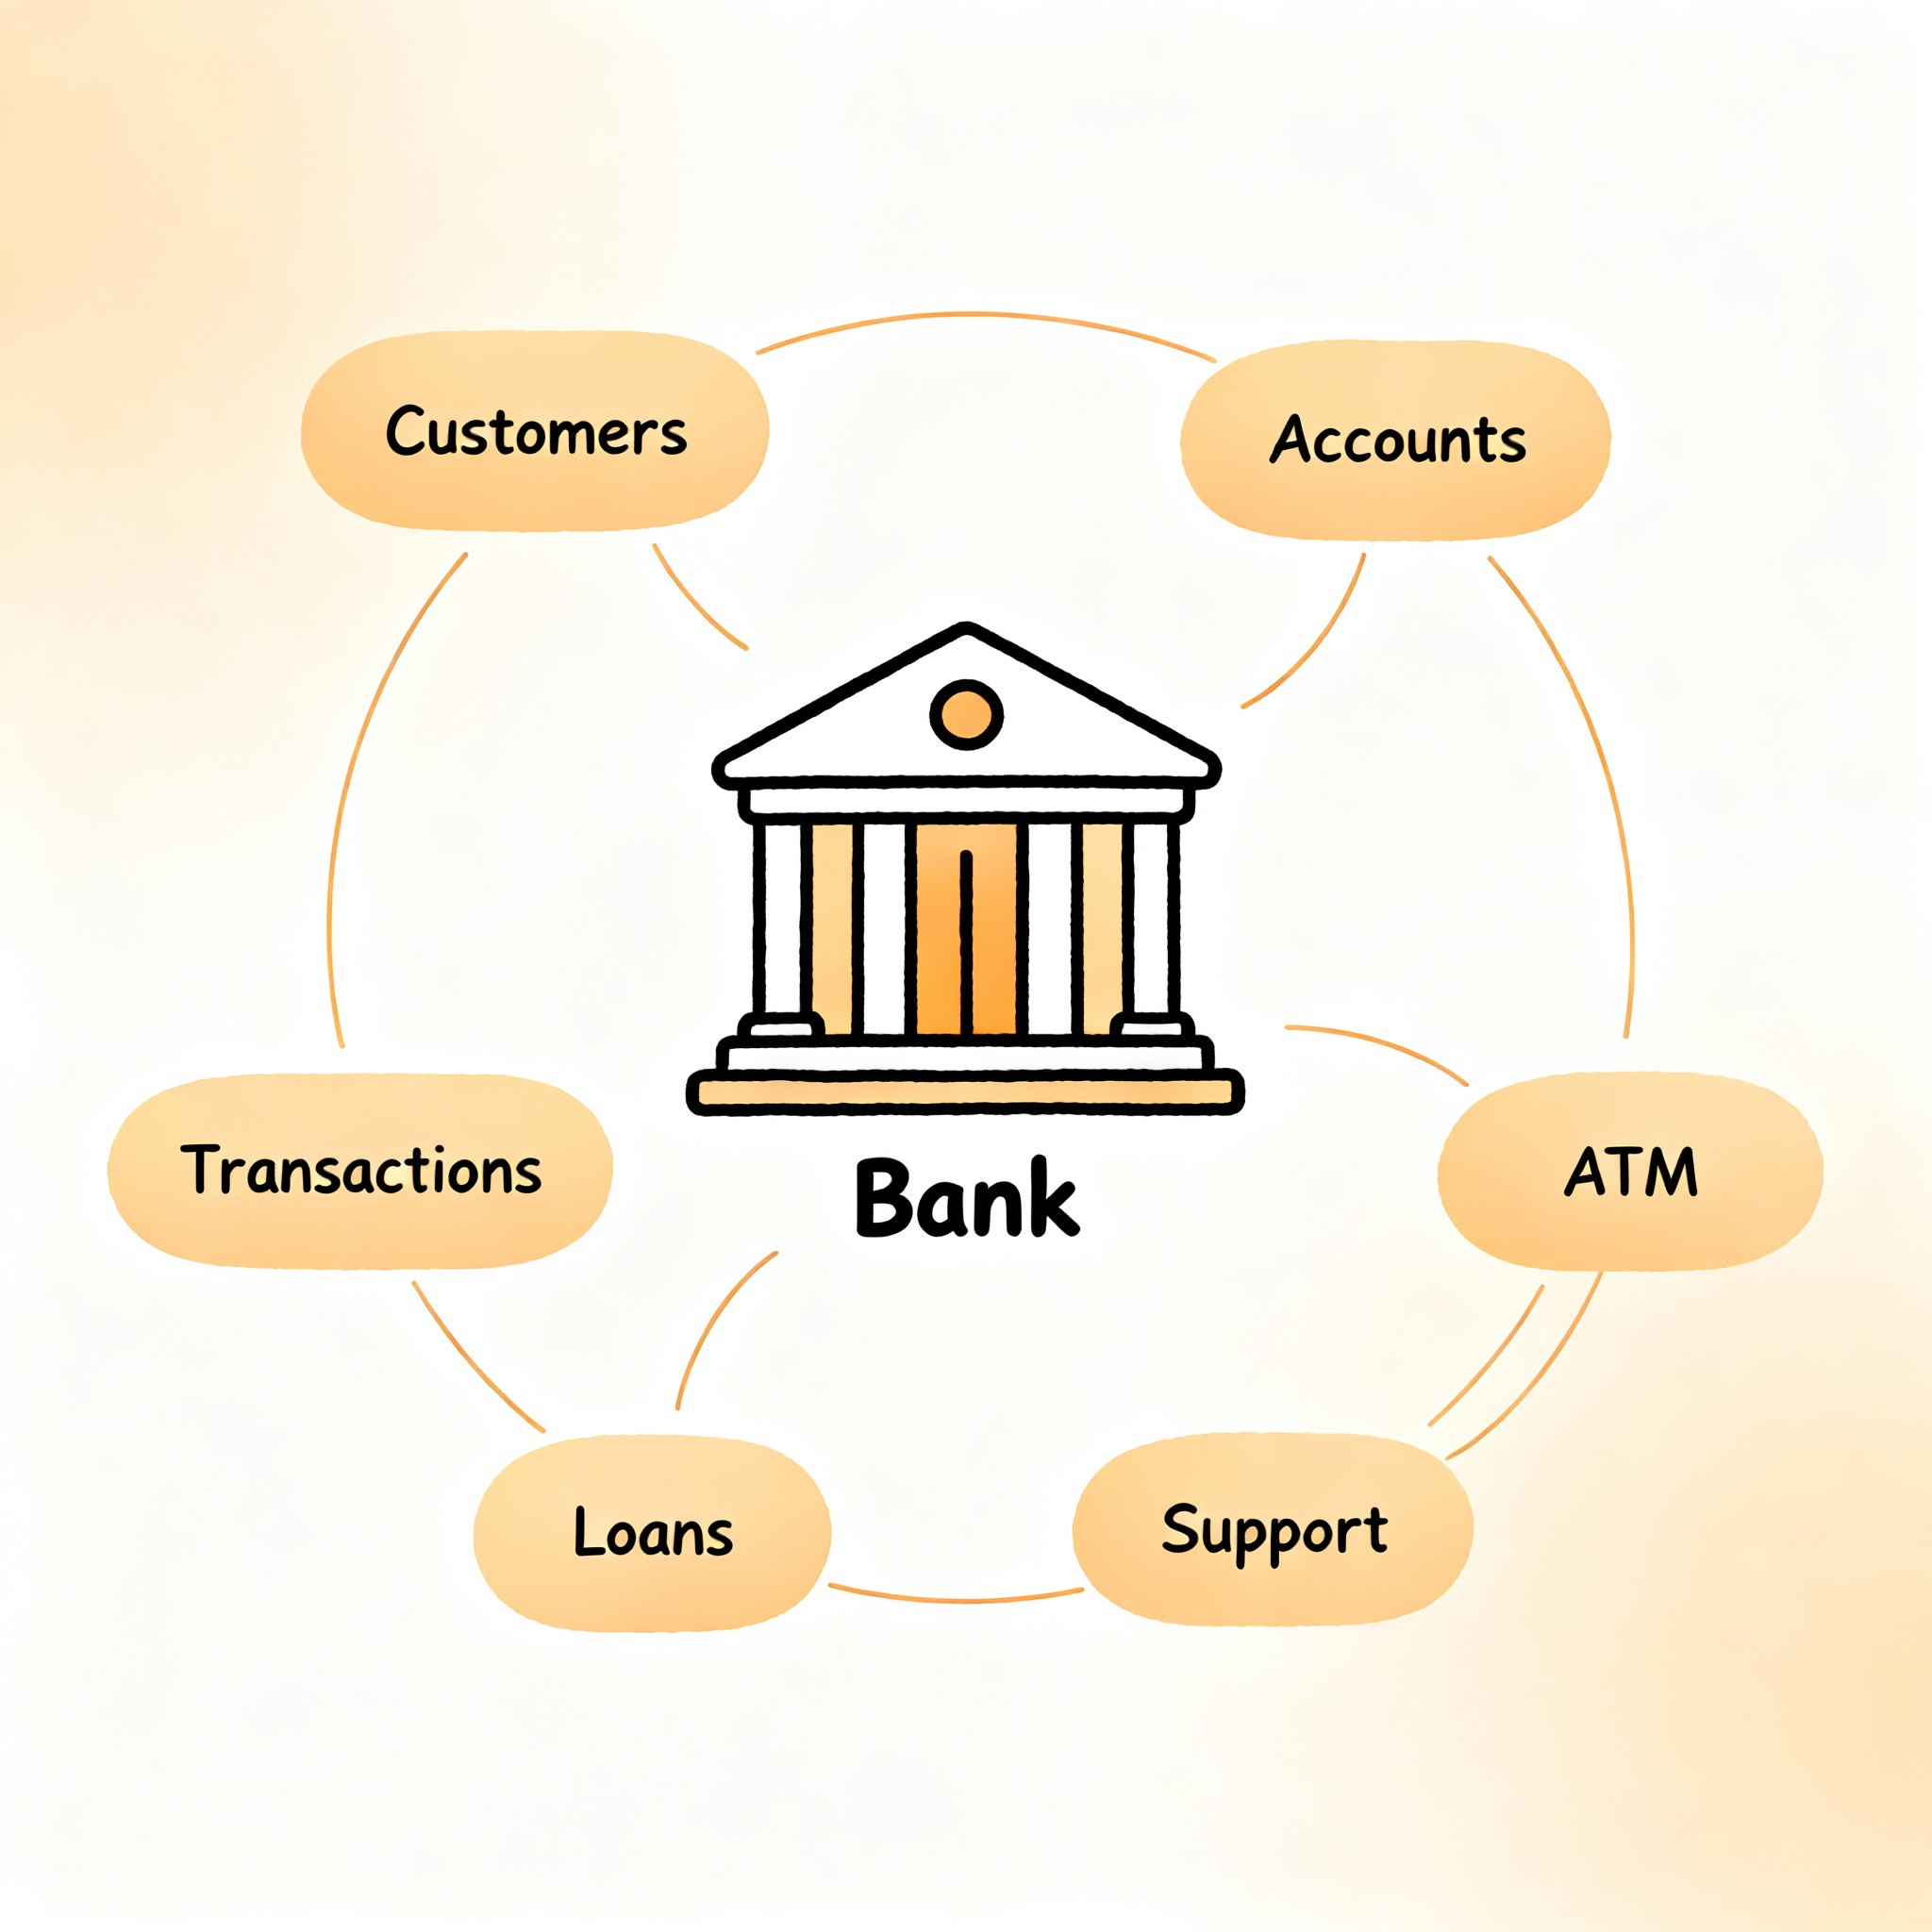
Bank System Example

Slide 20

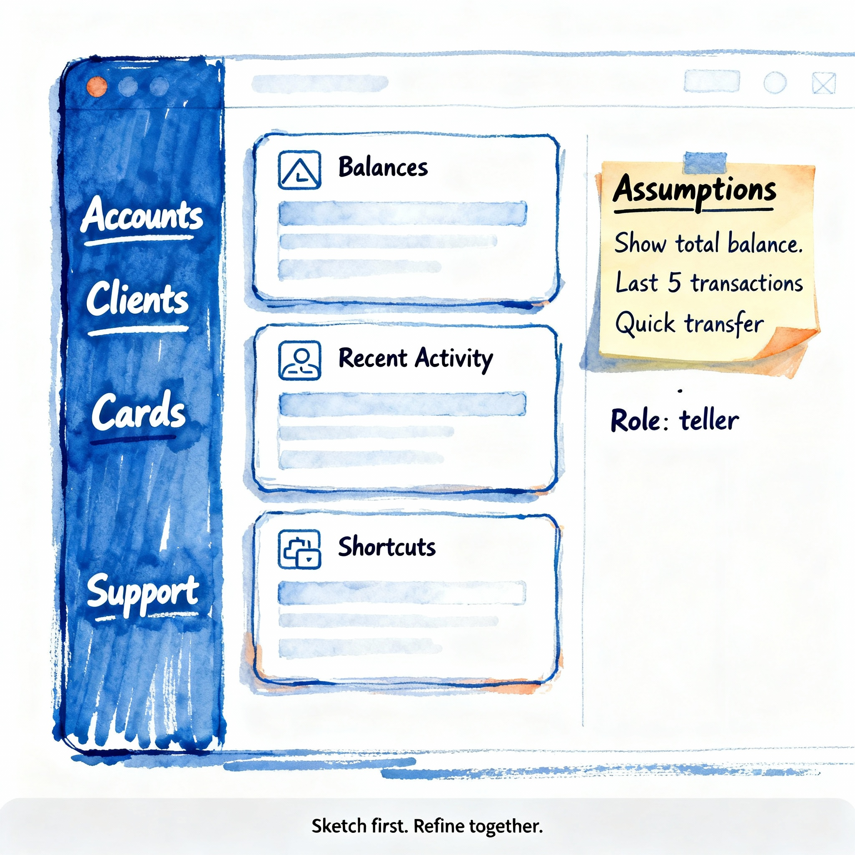
Our Running Example: The Bank Management System
A system to manage customers, their accounts, and core financial activities
Purpose: model key banking functions, focusing on safe customer and financial management
Key entities: Customers (the people), Accounts (the money holders), and Transactions (the actions)
Key operations: open/close accounts, deposit/withdraw funds, check balances, and transfer money

Slide 21



Domain sketch: the bank
Customers hold accounts; Accounts hold money
Customer
Account
Transaction
The central entity, representing the owner with a unique ID and contact info
All financial activity begins with a customer
A container for money, identified by an account number and owned by a customer
It holds the balance and has rules for deposits and withdrawals
An immutable record of a single financial event, like a deposit or transfer
It provides the essential audit trail for every account

Slide 22

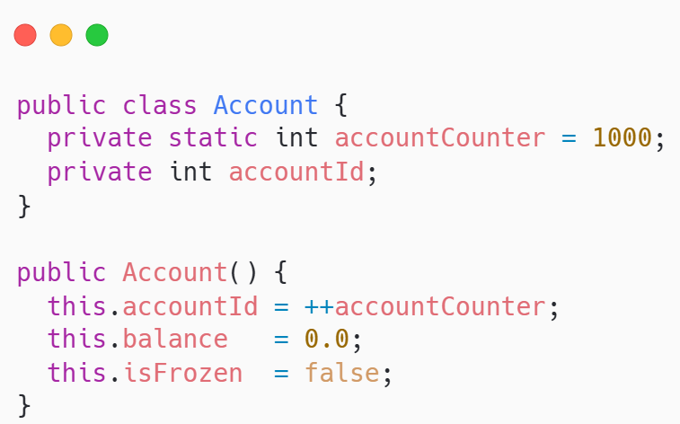
Static in Account — Unique IDs
Use a static counter to assign unique IDs to each account
Keep a private static counter that increments on every Account creation
Set accountId in the constructor using the incremented counter value

Slide 23
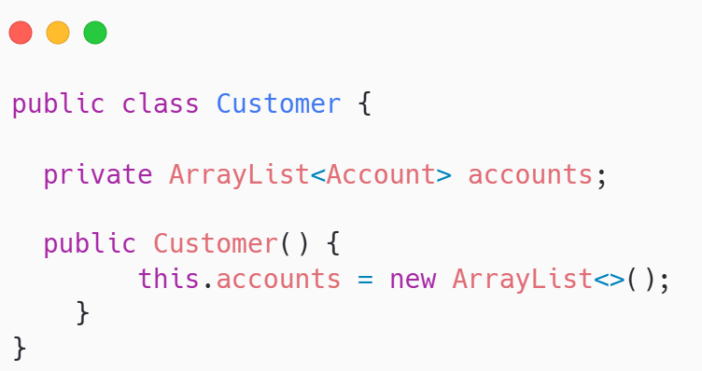
Customer — Accounts List (One-to-Many)
A customer manages many accounts through a private list
Store accounts in private ArrayList<Account> to protect internal state
Initialize the list in the constructor to ensure it’s always usable

Slide 24

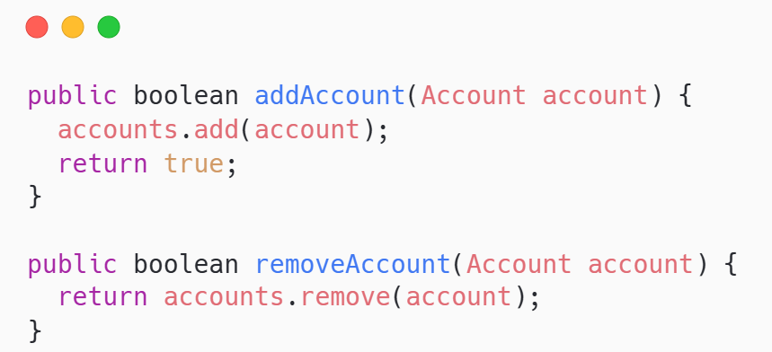
Customer — Add, Remove, Search
Provide simple, clear methods to manage a customer’s accounts
addAccount(Account a): validate non-null and avoid duplicates before adding
removeAccount(Account a or id): return boolean; log not-found cases
findAccount(int id): iterate list, compare getAccountId(), return the match or null

Slide 25

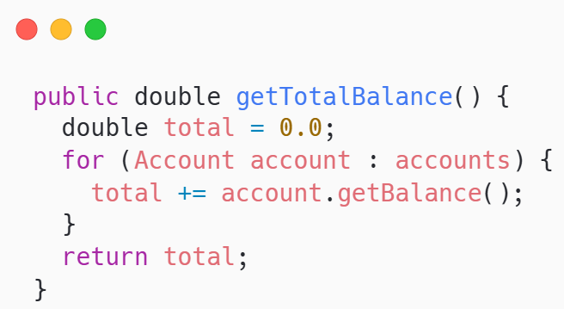
Customer — Totals and Operations
Compute totals and route operations to the right account
getTotalBalance(): sum account.getBalance() across the accounts list
deposit(id, amount) and withdraw(id, amount): locate account, then delegate

Slide 26


Key Takeaways & Next Steps
Use static wisely; model relationships manage objects with collections
Static is for class-level data like counters; avoid global mutable state overuse
ArrayList is the default for dynamic groups of objects in application code
Relationships + collections let objects collaborate to mirror real systems
Design cleaner systems by separating responsibilities and reducing coupling

Slide 27


Quote of the week
Keep good company Count what counts. Prune your list

